Slide 1
Kafka Source Demo for issue number 254 https://github.com/opensearch-project/data-prepper/issues/254

Slide 2
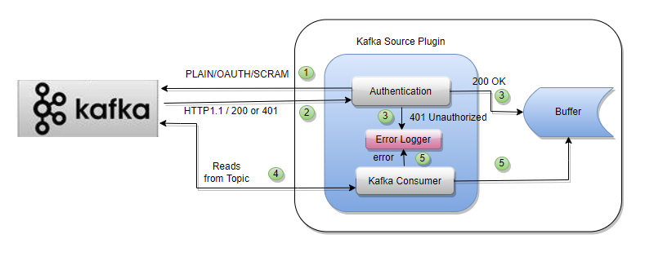
Kafka Source Plugin Flow

Slide 3
Pipeline Configuration
Pipelines.yaml
log-pipeline: source: kafka: bootstrap_servers: - pkc-ymrq7.us-east-2.aws.confluent.cloud:9092 client_dns_lookup: use_all_dns_ips encryption: plaintext topics: - name: topic-json workers: 5 auto_commit: false auto_commit_interval: PT5S session_timeout: 45000 max_retry_attempts: 1000 auto_offset_reset: earliest thread_waiting_time: PT1S

Slide 4
Pipeline Configuration
Pipelines.yaml
max_record_fetch_time: PT4S heart_beat_interval: PT3S buffer_default_timeout: PT5S fetch_max_bytes: 52428800 fetch_max_wait: 500 fetch_min_bytes: 1 retry_backoff: PT100S consumer_max_poll_records: 500 schema: registry_url: https://psrc-em82q.us-east-2.aws.confluent.cloud version: 1 schema_registry_api_key: 7QV2UXHRVNOC6AJD schema_registry_api_secret: 6M9xLZDIfmyBN9cqNm2n9GU23mleiaIHJWqQeA5P4JY basic_auth_credentials_source: USER_INFO session_timeout_ms: 45000

Slide 5
Pipeline Configuration
Pipelines.yaml
aws: msk: arn: service_arn broker_connection_type: public region: us-east-2 sts_role_arn: sts_role_arn authentication: insecure: true/false sasl: msk_iam: role plaintext: security_protocol: SASL_SSL username: 5UH4NID4OENKDIBI password: jCmncn77F9asfox3yhgZLCE95aIe1UubX

Slide 6
Pipeline Configuration
Pipelines.yaml
oauth: oauth_client_id: 0oa9wc21447Pc5vsV5d7 oauth_client_secret: aGmOfHqIEvBJGDxXAOOcatiE9PvsPgoEePx8IPPa oauth_login_server: https://dev-13650048.okta.com oauth_login_endpoint: /oauth2/default/v1/token oauth_login_grant_type: refresh_token oauth_login_scope: kafka oauth_introspect_server: https://dev-13650048.okta.com oauth_introspect_endpoint: /oauth2/default/v1/introspect oauth_token_endpoint_url: https://dev-13650048.okta.com/oauth2/default/v1/token oauth_security_protocol: SASL_SSL oauth_sasl_mechanism: OAUTHBEARER oauth_sasl_login_callback_handler_class: org.apache.kafka.common.security.oauthbearer.secured.OAuthBearerLoginCallbackHandler oauth_jwks_endpoint_url: https://dev-13650048.okta.com/oauth2/default/v1/keys extension_logicalCluster: lkc-yggz7j extension_identityPoolId: pool-RXzn

Slide 7
Test Scenarios
Multithreaded Kafka source consumer
Deserializer for JSON
Single broker with multi topic
Multiple data-prepper instance with multi topic
Deserializer for Plain Text / Json/ Avro

Slide 8
Test Scenarios
Multiple broker with multi topic
Schema registry connectivity
Kafka cloud cluster connectivity
Supports Confluent Schema registry and Okta
Multiple broker – multi topic with multiple data-prepper instances

Slide 9
Test Scenarios
Consumer rebalance
Retry mechanisms to write to the data-prepper buffer
Supports authentication mechanisms PLAIN and AUTHBEARER
Supports auth protocols PLAINTEXT, SASL_PLAINTEXT and SASL_SSL
E2E acknowledgement

Slide 10
Error/Exception Scenarios
The Kafka broker is not available.
The authentication fails to the Kafka broker/ clusters.
The authentication fails the Schema Registry
The given topic is not available.
The given Schema registry URL is not available.
The given Schema version is not available.
The user makes any TYPO mistake in the supplied configurations.
Any invalid data while reading from the topic.
Timeout occurs during the Schema registry connectivity.

